Slide 1





COP 5725
School of Computer and Information Sciences
Francisco R. Ortega, Ph.D.
Lecture #6 – R & G Ch. 9
Storing Data

Slide 2


Book and Materials
Most of the material here has been obtained from the following Sources:
R & G Book
R & G Resources (Web,…)
Dr. Rishe’s Semantic DB Book
Dr. Pavlo’s material (CMU)
Additional publications
NoSQL Book
Additional Resources will be announced.

Slide 3
Overview
Memory hierarchy
RAID (briefly)
Disk space management
Buffer management
Files of records
Page Formats
Record Formats

Slide 4
DBMS Layers:
Queries
Query Optimization
and Execution
Relational Operators
Files and Access Methods
TODAY →
Buffer Management
Disk Space Management
DB

Slide 5
Leverage OS for disk/file management?
Layers of abstraction are good … but:

Slide 6
Leverage OS for disk/file management?
Layers of abstraction are good … but:
Unfortunately, OS often gets in the way of DBMS

Slide 7
Leverage OS for disk/file management?
DBMS wants/needs to do things “its own way”
Specialized prefetching
Control over buffer replacement policy
LRU not always best (sometimes worst!!)
Control over thread/process scheduling
“Convoy problem”
Arises when OS scheduling conflicts with DBMS locking
Control over flushing data to disk
WAL protocol requires flushing log entries to disk

Slide 8
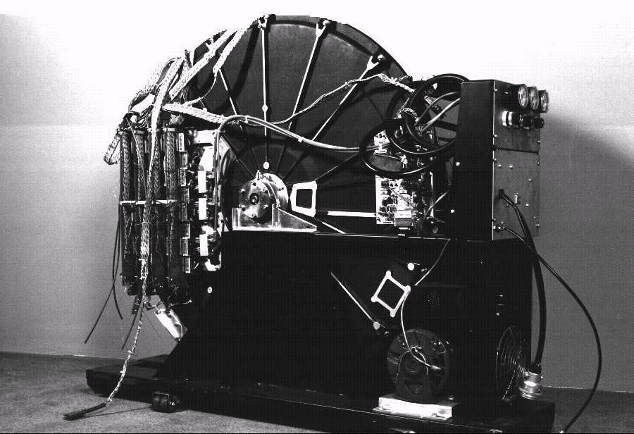
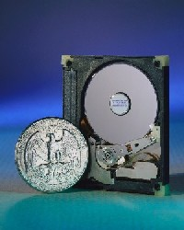
Disks and Files
DBMS stores information on disks.
but: disks are (relatively) VERY slow!
Major implications for DBMS design!

Slide 9
Disks and Files
Major implications for DBMS design:
READ: disk -> main memory (RAM).
WRITE: reverse
Both are high-cost operations, relative to in-memory operations, so must be planned carefully!

Slide 10
Why Not Store It All in Main Memory?

Slide 11
Why Not Store It All in Main Memory?
Costs too much.
disk: ~$0.1/Gb; memory: ~$10/Gb
High-end Databases today in the 10-100 TB range.
Approx 60% of the cost of a production system is in the disks.
Main memory is volatile.
Note: some specialized systems do store entire database in main memory.

Slide 12
The Storage Hierarchy
Smaller, Faster
Bigger, Slower

Slide 13
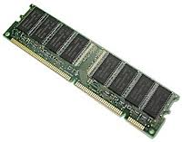
The Storage Hierarchy
Smaller, Faster
Registers
Main memory (RAM) for currently used data.
Disk for the main database (secondary storage).
Tapes for archiving older versions of the data (tertiary storage).
L1 Cache
.
.
.
Main Memory
Magnetic Disk
Magnetic Tape
Bigger, Slower

Slide 14
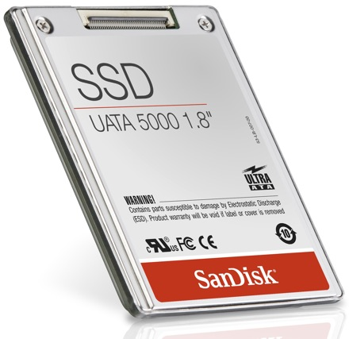
The Storage Hierarchy
Smaller, Faster
Registers
Main memory (RAM) for currently used data.
Disk for the main database (secondary storage).
Tapes for archiving older versions of the data (tertiary storage).
L1 Cache
Main Memory
SSD
Magnetic Disk
Magnetic Tape
Bigger, Slower

Slide 15

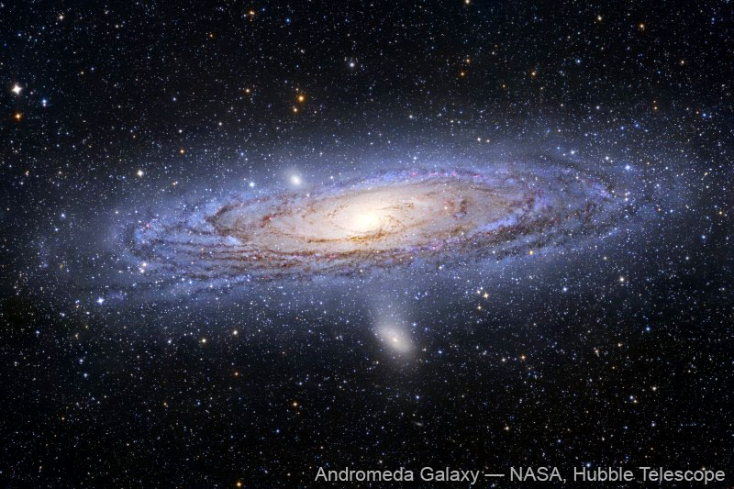
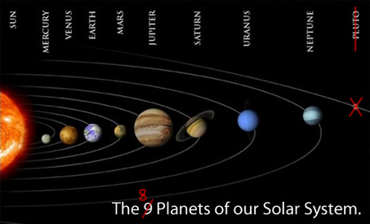

Jim Gray’s Storage Latency Analogy: How Far Away is the Data?
10**9 tape
10**6 disk
100 Memory
10 On board cache
2 on chip cache
1 registers
Andromeda
2,000yr
2yr
1.5h
10min
1min
Pluto
Pittsburgh
This building
This room
In my head

Slide 16
Disks
Secondary storage device of choice.
Main advantage over tapes: random access vs. sequential.
Data is stored and retrieved in units called disk blocks or pages.
Unlike RAM, time to retrieve a disk page varies depending upon location on disk.
relative placement of pages on disk is important!

Slide 17
Anatomy of a Disk
Spindle
Disk head
Tracks
Sector
Track
Cylinder
Platter
Block size = multiple of sector size (which is fixed)
Sector
Arm movement
Platters
Arm assembly

Slide 18
Accessing a Disk Page
Time to access (read/write) a disk block:
.
.
.

Slide 19
Accessing a Disk Page
Time to access (read/write) a disk block:
seek time: moving arms to position disk head on track
rotational delay: waiting for block to rotate under head
transfer time: actually moving data to/from disk surface

Slide 20
Seek Time
…
A?
Arm movement
B?
3x to 20x
C?
Time
x
1
N
Cylinders Traveled

Slide 21
Seek Time
…
Arm movement
3x to 20x
Time
x
1
N
Cylinders Traveled

Slide 22
Rotational Delay
Head Here
Block I Want

Slide 23
Accessing a Disk Page
Relative times?
seek time:
rotational delay:
transfer time:

Slide 24
Accessing a Disk Page
Relative times?
seek time: about 1 to 20msec
rotational delay: 0 to 10msec
transfer time: < 1msec per 4KB page
Seek
Rotate
transfer
Transfer

Slide 25
Seek time & rotational delay dominate
Key to lower I/O cost: reduce seek/rotation delays!
Also note: For shared disks, much time spent waiting in queue for access to arm/controller
Seek
Rotate
transfer

Slide 26
Arranging Pages on Disk
…
“Next” block concept:
blocks on same track, followed by
blocks on same cylinder, followed by
blocks on adjacent cylinder
Accesing ‘next’ block is cheap
An important optimization: pre-fetching
See R&G page 323
Q1: Why
not
equal?
Q2: Why?

Slide 27
Rules of thumb…
Memory access much faster than disk I/O (~ 1000x)
“Sequential” I/O faster than “random” I/O (~ 10x)
write on blackboard

Slide 28
Overview
Memory hierarchy
RAID (briefly)
Disk space management
Buffer management
Files of records
Page Formats
Record Formats

Slide 29
Disk Arrays: RAID
Logical
Physical
Benefits:
Higher throughput (via data “striping”)
Longer MTTF
(Why?)

Slide 30
Disk Arrays: RAID
Logical
Physical
Benefits:
Higher throughput (via data “striping”)
Longer MTTF (via redundancy)

Slide 31
Overview
Memory hierarchy
RAID (briefly)
Disk space management
Buffer management
Files of records
Page Formats
Record Formats

Slide 32
Disk Space Management
Lowest layer of DBMS software manages space on disk
Higher levels call upon this layer to:
allocate/de-allocate a page
read/write a page
Best if requested pages are stored sequentially on disk! Higher levels don’t need to know if/how this is done, nor how free space is managed.

Slide 33
Overview
Memory hierarchy
RAID (briefly)
Disk space management
Buffer management
Files of records
Page Formats
Record Formats

Slide 34
Recall: DBMS Layers
Queries
Query Optimization
and Execution
Relational Operators
Files and Access Methods
TODAY →
Buffer Management
Disk Space Management
DB

Slide 35
Buffer Management in a DBMS
Page Requests from Higher Levels
(copy of a)
disk page
buffer
pool
free frame
MAIN MEMORY
DISK
choice of frame dictated
by replacement policy
DB

Slide 36
Buffer Management in a DBMS
Data must be in RAM for DBMS to operate on it!
Buffer Mgr hides the fact that not all data is in RAM

Slide 37
When a Page is Requested ...
Buffer pool information table contains: <???>
If requested page is not in pool:
Choose an (un-pinned) frame for replacement
If frame is “dirty”, write it to disk
Read requested page into chosen frame
Pin the page and return its address

Slide 38
When a Page is Requested ...
Buffer pool information table contains: <frame#, pageid, pin_count, dirty-bit>
If requested page is not in pool:
Choose an (un-pinned) frame for replacement
If frame is “dirty”, write it to disk
Read requested page into chosen frame
Pin the page and return its address

Slide 39
When a Page is Requested ...
If requests can be predicted (e.g., sequential scans)
then pages can be pre-fetched several pages at a time!

Slide 40
More on Buffer Management
When done, requestor of page must
unpin it, and
indicate whether page has been modified: dirty bit
Page in pool may be requested many times:
pin count
if pin count = 0 (“unpinned”), page is candidate for replacement

Slide 41
More on Buffer Management
CC & recovery may entail additional I/O when a frame is chosen for replacement. (Write-Ahead Log protocol; more later.)

Slide 42
Buffer Replacement Policy
Frame is chosen for replacement by a replacement policy:
Least-recently-used (LRU), MRU, Clock, etc.
Policy -> big impact on # of I/O ’s; depends on the access pattern.

Slide 43
LRU Replacement Policy
Least Recently Used (LRU)
for each page in buffer pool, keep track of time last unpinned
replace the frame which has the oldest (earliest) time
very common policy: intuitive and simple
Problems?

Slide 44
LRU Replacement Policy
Problem: Sequential flooding
LRU + repeated sequential scans.
# buffer frames < # pages in file means each page request causes an I/O. MRU much better in this situation (but not in all situations, of course).

Slide 45
Sequential Flooding – Illustration
BUFFER POOL
LRU:
102
116
242
105
BUFFER POOL
MRU:
102
116
242
105
1
2
3
4
5
6
7
8
Repeated scan of file …

Slide 46
Sequential Flooding – Illustration
BUFFER POOL
LRU:
1
116
242
105
BUFFER POOL
MRU:
102
116
242
105
1
2
3
4
5
6
7
8
Repeated scan of file …

Slide 47
Sequential Flooding – Illustration
BUFFER POOL
LRU:
1
2
242
105
BUFFER POOL
MRU:
102
116
242
105
1
2
3
4
5
6
7
8
Repeated scan of file …

Slide 48
Sequential Flooding – Illustration
BUFFER POOL
LRU:
1
2
3
105
BUFFER POOL
MRU:
102
116
242
105
1
2
3
4
5
6
7
8
Repeated scan of file …

Slide 49
Sequential Flooding – Illustration
BUFFER POOL
LRU:
1
2
3
4
BUFFER POOL
MRU:
102
116
242
105
1
2
3
4
5
6
7
8
Repeated scan of file …

Slide 50
How will MRU work?

Slide 51
Sequential Flooding – Illustration
BUFFER POOL
LRU:
1
2
3
4
will not re-use these pages;
BUFFER POOL
MRU:
102
116
242
105
1
2
3
4
5
6
7
8
Repeated scan of file …

Slide 52
Sequential Flooding – Illustration
BUFFER POOL
LRU:
1
2
3
4
will not re-use these pages;
BUFFER POOL
MRU:
1
116
242
105
1
2
3
4
5
6
7
8
Repeated scan of file …

Slide 53
Sequential Flooding – Illustration
BUFFER POOL
LRU:
1
2
3
4
will not re-use these pages;
BUFFER POOL
MRU:
2
116
242
105
1
2
3
4
5
6
7
8
Repeated scan of file …

Slide 54
Sequential Flooding – Illustration
BUFFER POOL
LRU:
1
2
3
4
will not re-use these pages;
BUFFER POOL
MRU:
3
116
242
105
1
2
3
4
5
6
7
8
Repeated scan of file …

Slide 55
Sequential Flooding – Illustration
BUFFER POOL
LRU:
1
2
3
4
will not re-use these pages;
BUFFER POOL
MRU:
4
116
242
105
1
2
3
4
5
6
7
8
Repeated scan of file …

Slide 56
Other policies?
LRU is often good - but needs timestamps and sorting on them
something easier to maintain?

Slide 57
“Clock” Replacement Policy
Main ideas:
Approximation of LRU.
Instead of maintaining & sorting time-stamps, find a ‘reasonably old’ frame to evict.
How? by round-robin, and marking each frame - frames are evicted the second time they are visited.
Specifically:

Slide 58
“Clock” Replacement Policy
Arrange frames into a cycle, store
one “reference bit” per frame
When pin count goes to 0, reference bit set on (= ‘one life left’ - not ready for eviction yet)
When replacement necessary, get the next frame that has reference-bit = 0
A(1)
D(0)
B(1)
C(1)

Slide 59
“Clock” Replacement Policy
do {
if (pincount == 0 && ref bit is off)
choose current page for replacement;
else if (pincount == 0 && ref bit is on)
turn off ref bit;
advance current frame;
} until a page is chosen for replacement;
A(1)
D(0)
B(1)
C(1)

Slide 60
“Clock” Replacement Policy
A(1)
D(0)
B(0)
C(1)

Slide 61
“Clock” Replacement Policy
A(1)
D(0)
B(0)
C(0)

Slide 62
“Clock” Replacement Policy
A(1)
D(0)
B(0)
C(0)

Slide 63
Summary
Buffer manager brings pages into RAM.
Very important for performance
Page stays in RAM until released by requestor.
Written to disk when frame chosen for replacement (which is sometime after requestor releases the page).
Choice of frame to replace based on replacement policy.
Good to pre-fetch several pages at a time.

Slide 64
Overview
Memory hierarchy
RAID (briefly)
Disk space management
Buffer management
Files of records
Page Formats
Record Formats

Slide 65
Files
FILE: A collection of pages, each containing a collection of records.
Must support:
insert/delete/modify record
read a particular record (specified using record id)
scan all records (possibly with some conditions on the records to be retrieved)

Slide 66
Alternative File Organizations
Several alternatives (w/ trade-offs):
Heap files: Suitable when typical access is a file scan retrieving all records.
Sorted Files:
Index File Organizations:
later

Slide 67
Files of records
Heap of pages
as linked list or
directory of pages

Slide 68
Heap File Using Lists
Data
Page
Data
Page
Data
Page
Full Pages
Header
Page
Free
Page
Free
Page
Free
Page
Pages with
Free Space
The header page id and Heap file name must be stored someplace.
Each page contains 2 `pointers’ plus data.

Slide 69
Heap File Using Lists
Data
Page
Data
Page
Data
Page
Full Pages
Header
Page
Free
Page
Free
Page
Free
Page
Pages with
Free Space
Any problems?

Slide 70
Heap File Using a Page Directory
Data
Page 1
Header
Page
Data
Page 2
Data
Page N
DIRECTORY

Slide 71
Heap File Using a Page Directory
The entry for a page can include the number of free bytes on the page.
The directory is a collection of pages; linked list implementation is just one alternative.
Much smaller than linked list of all HF pages!

Slide 72
Overview
Memory hierarchy
RAID (briefly)
Disk space management
Buffer management
Files of records
Page Formats
Record Formats

Slide 73
Page Formats
fixed length records
variable length records

Slide 74
Problem definition
Q: How would you store records on a page/file, such that
you can point to them
you can insert/delete records with few disk accesses
4kb page

Slide 75
Page Formats
Important concept: rid == record id
Q0: why do we need it?
Q1: How to mark the location of a record?
Q2: Why not its byte offset in the file?

Slide 76
Page Formats
Important concept: rid == record id
Q0: why do we need it?
A0: eg., for indexing
Q1: How to mark the location of a record?
A1:
Q2: Why not its byte offset in the file?
A2:

Slide 77
Page Formats
Important concept: rid == record id
Q0: why do we need it?
A0: eg., for indexing
Q1: How to mark the location of a record?
A1:
Q2: Why not its byte offset in the file?
A2: too much re-organization on ins/del.

Slide 78
Page Formats
Important concept: rid == record id
Q0: why do we need it?
A0: eg., for indexing
Q1: How to mark the location of a record?
A1: rid = record id = page-id & slot-id
Q2: Why not its byte offset in the file?
A2: too much re-organization on ins/del.

Slide 79
Fixed length records
Q: How would you store them on a page/file?
4kb page

Slide 80
Fixed length records
Q: How would you store them on a page/file?
A1: How about:
slot #1
slot #2
‘Packed’
...
slot #N
free space
N
number of full slots

Slide 81
Fixed length records
OK – how about insertion?
slot #1
slot #2
‘Packed’
...
slot #N
free space
N
number of full slots

Slide 82
Fixed length records
OK – how about insertion?
slot #1
slot #2
‘Packed’
...
slot #N
free space
N+1
number of full slots

Slide 83
Fixed length records
How about deletion?
slot #1
xxxxxxxx
slot #2
‘Packed’
...
slot #N
free space
N
number of full slots

Slide 84
Fixed length records
How about deletion?
Bad - we have too much to reorganize/update
slot #1
B-tree
xxxxxxxx
slot #2
...
slot #N
free space
N
number of full slots

Slide 85
Fixed length records
What would you do?

Slide 86
Fixed length records
Q: How would you store them on a page/file?
A2: Bitmaps
slot #1
slot #2
...
free slots
slot #N
1
0
M
page header

Slide 87
Fixed length records
Q: How would you store them on a page/file?
A2: Bitmaps : ✔ insertions, ✔ deletions
slot #1
slot #2
...
free slots
slot #N
1
0
M
page header

Slide 88
Variable length records
Q: How would you store them on a page/file?
occupied records
...
page header

Slide 89
Variable length records
SLOTTED PAGE
Q: How would you store them on a page/file?
pack them
keep ptrs to them
occupied records
...
...
page header
slot directory
other info (# slots etc)

Slide 90
Variable length records
SLOTTED PAGE
Q: How would you store them on a page/file?
pack them
keep ptrs to them
mark start of free space
occupied records
...
...
page header
slot directory
other info (# slots etc)

Slide 91
Variable length records
SLOTTED PAGE
Q: How would you store them on a page/file?
occupied records
how many disk accesses to insert a record?
to delete one?
...
...
page header

Slide 92
Variable length records
SLOTTED PAGE
SLOTTED PAGE organization - popular.
occupied records
...
...
page header

Slide 93
Overview
Memory hierarchy
RAID (briefly)
Disk space management
Buffer management
Files of records
Page Formats
Record Formats

Slide 94
Formats of records
Fixed length records
How would you store them?
Variable length records

Slide 95
Record Formats: Fixed Length
F1
F2
F3
F4
L1
L2
L3
L4
Base address (B)
Address = B+L1+L2
Information about field types same for all records in a file; stored in system catalogs.
Finding i’th field done via arithmetic.

Slide 96
Formats of records
Fixed length records: straightforward - store info in catalog
Variable length records: encode the length of each field
?
?

Slide 97
Formats of records
Fixed length records: straightforward - store info in catalog
Variable length records: encode the length of each field
store its length or
use a field delimiter

Slide 98
Variable Length records
Two alternative formats (# fields is fixed):
F1 F2 F3 F4
$
$
$
$
Fields Delimited by Special Symbols
F1 F2 F3 F4
Array of Field Offsets
Pros and cons?

Slide 99
Variable Length records
Two alternative formats (# fields is fixed):
F1 F2 F3 F4
$
$
$
$
Fields Delimited by Special Symbols
F1 F2 F3 F4
Array of Field Offsets
Offset approach: usually superior (direct access to i-th field)

Slide 100
Conclusions
Memory hierarchy
Disks: (>1000x slower) - thus
pack info in blocks
try to fetch nearby blocks (sequentially)
Buffer management: very important
LRU, MRU, Clock, etc
Record organization: Slotted page
Main Memory
SSD
Magnetic Disk
...

